Slide 1
LMS CASE STUDY PRESENTATION
- REVATHI BOOPATHI

Slide 2
AGENDA
Business Understanding
Data Overview
Data Insights
Dropout prediction model performance
Model Productization
Other Data Science Ideas for LMS

Slide 3
LMS business understanding
Problem Statement
Course drop-outs impact Client customers negatively
Motivation
There is a need to predict course drop-outs early in order to maximize employee learning long-term success for Client customers

Slide 4
AGENDA
Business Understanding
Data Overview
Data Insights
Dropout prediction model performance
Model Productization
Other Data Science Ideas for LMS

Slide 5
Factors affecting dropout
Employee drop-out depends on:
Demographic factors
Gender
Highest education level
Geographical factors
Location of an employee
Tax returns/estimated population
Total wages/population
Enrollment activity related factors
Time spent on each LMS event
Source of enrollment
Number of LMS events identified
Total time spent in any kind of LMS event

Slide 6
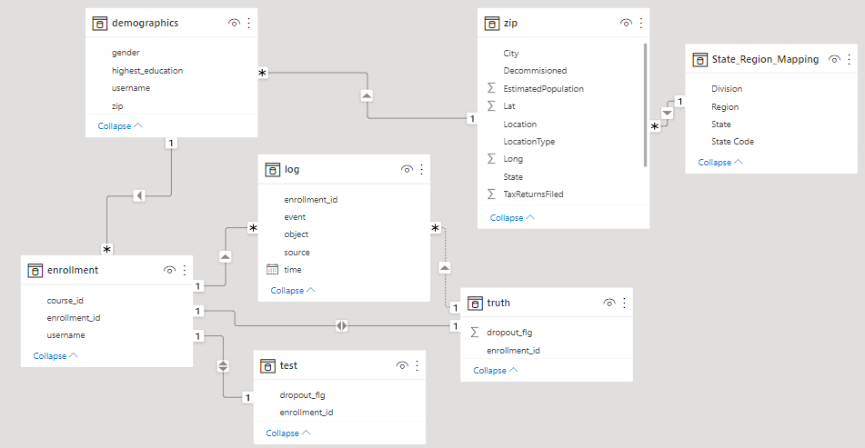
Data connection

Slide 7
AGENDA
Business Understanding
Data Overview
Data Insights
Dropout prediction model performance
Model Productization
Other Data Science Ideas for LMS

Slide 8
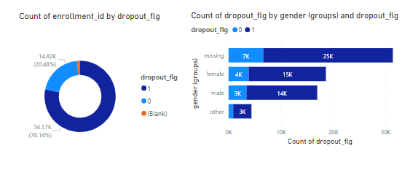
Data Insights - overall
78% of dropouts are observed in total between 10/2013 to 8/2014
The dataset is imbalanced with many employees dropping out from courses

Slide 9
Data Insights - Gender
It is observed from gender distribution vs dropout that most gender category contains missing values

Slide 10
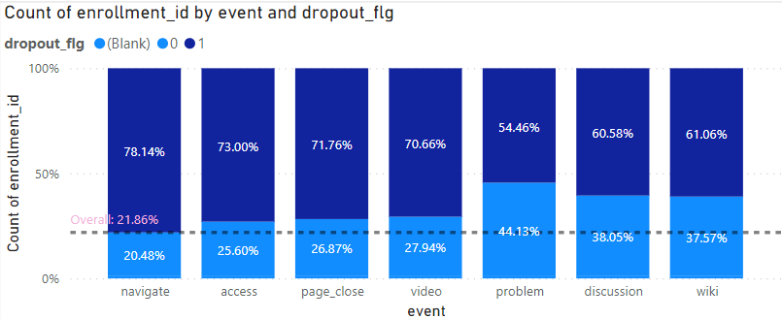
Data Insights - event
Enrollments from employees who usually engage with problem, discussion, wiki objects tend to drop out less because those employees are reading the content
This is evident from the change in percentage of drop out vs others

Slide 11
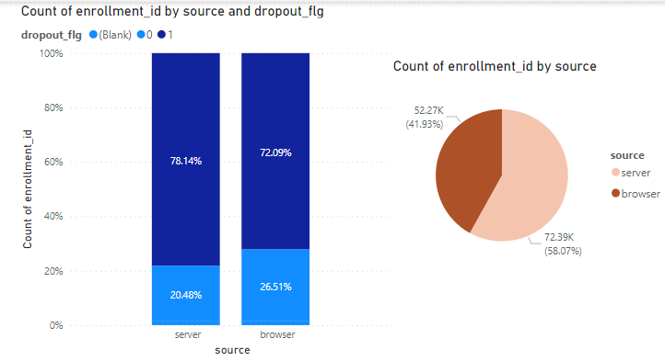
Data Insights
Server (using LMS application - assumed) consists of 58% of overall enrollments
Dropouts from enrollments from servers are higher compared to browser

Slide 12
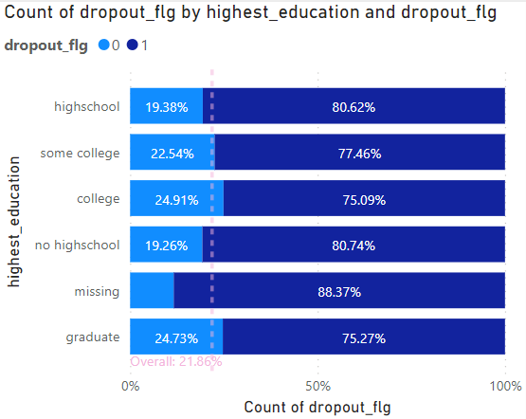
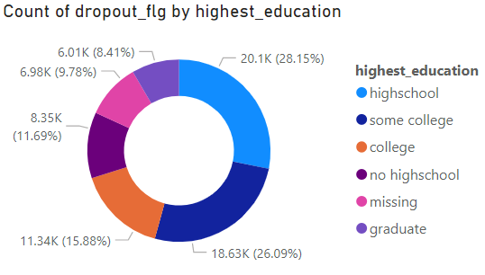
Data Insights
Lesser drop-outs compared to the overall average is observed in the case of employees who have studies till college and graduates

Slide 13
AGENDA
Business Understanding
Data Overview
Data Insights
Dropout prediction model performance
Model Productization
Other Data Science Ideas for LMS

Slide 14
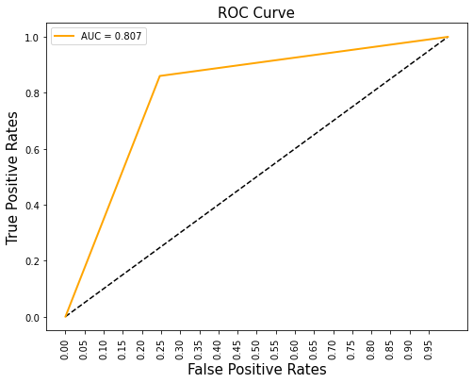
Modeling results – random forest
 | Accuracy | Precision | Recall | F1 Score | AUC
Without Hyperparameter tuning | 0.82 | 0.85 | 0.77 | 0.81 | 0.8
With Hyperparameter tuning | 0.81 | 0.84 | 0.75 | 0.80 | 0.807

Slide 15
Ensemble model selection reasoning
F1 Score (F1 on hyperparameter tuning: 0.8)
Precision: We should capture correctly classified dropouts to take necessary steps
+
Recall: Employee who is about to for sure dropout should be accurately predicted
Based on the above metric, Ensemble techniques perform well for this objective of predicting employee dropout

Slide 16
AGENDA
Business Understanding
Data Overview
Data Insights
Dropout prediction model performance
Model Productization
Other Data Science Ideas for LMS

Slide 17
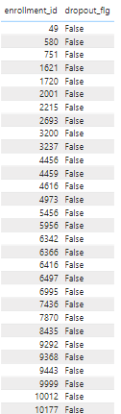
Model productization
Add role-based admin access in LMS for clients showing the employees about to be churned to take necessary actions
Insights on employee dropout
Future recommendations
Develop trigger settings in LMS for those enrollments that are about to dropout

Slide 18
AGENDA
Business Understanding
Data Overview
Data Insights
Dropout prediction model performance
Model Productization
Other Data Science Ideas for LMS

Slide 19
Data science ideas
How soon will an employee dropout? (Multi class classification – very soon, soon, later or regression - days)
This will help Client customers target and show personalized attention (an email) to employees who show an immediate dropout tendency rather than taking the same action for everyone
A test to identify the engagement towards objects of LMS(video, problem, etc.). Contents that are not performing well can be changed and an A/B test can be incorporated to analyze engagement and improvise the objects
Employee dashboard with data science insights (eg. If same streak is maintained, how many courses can be completed in the next n months)
Suggest relevant courses for employees based on content recommendation engine
Sentiment analysis for any discussion topic so that an employee is aware of the entire statistic of discussion

Slide 20
AGENDA
Business Understanding
Data Overview
Data Insights
Dropout prediction model performance
Model Productization
Other Data Science Ideas for LMS
References

Slide 21
REFERENCES
https://techrseries.com/payroll-and-compensation-management/Client-unveils-new-brand-identity-to-better-serve-a-changing-workplace/
https://public.opendatasoft.com/explore/dataset/georef-united-states-of-america-state/table/?disjunctive.ste_code&disjunctive.ste_name&sort=year

Slide 22
THANK YOU
Revathi Boopathi
408-754-7756
revathi.boopathi15081995@gmail.com
https://www.linkedin.com/in/revathi-boopathi-87153774/

Slide 23
AGENDA
Business Understanding
Data Overview
Data Insights
Dropout prediction model performance
Model Productization
Other Data Science Ideas for LMS
References
Appendix

Slide 24
Data preprocessing
New features created
Proportion of tax filed
Wage per person in a specific location
Time on an LMS event/ total duration of time spent on LMS events
Number of LMS event on which activity shown
Missing Value Handling
Gender
Total Wages
Data Filtering
Locations in United States
Decommissioned zip codes elimination

Slide 25

Feature selection
Feature Selection
Categorical Features
Chi squared test of independence
Significance Level of 5%
Eliminated ‘zip code type’ and ‘state’ features
Numerical - Correlation plot

Slide 26
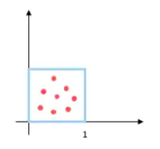
Data scaling
DATA NORMALISATION
Numerical fields

Slide 27
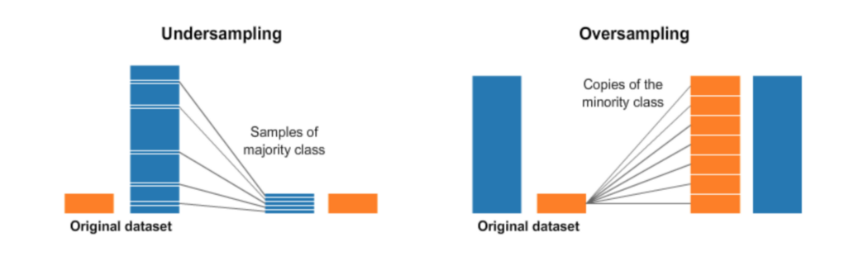

Sampling methods
Undersampling
Downsampling
Sampling
Upsampling
Oversampling
Upsampling with SMOTE

Slide 28
Data splitting
TRAINING SET ( 70% )
VALIDATION SET ( 30%)

